Slide 1

Working With Data DATA9910
Week 11
Lucas Rizzo
email: lucas.rizzo@tudublin.ie

Slide 2
Schedule
Week 1 | Set up environment and R notebook
Week 2 | Review Python and practice
Week 3 | Importing data with R
Week 4 | Interpreting Data (summary statistics, data visualisation)
Week 5 | Data manipulation in R. Numpy and Pandas introduction in Python.
Week 6 | Review week (work on assignment)
Week 7 | Data visualisation in Python
Week 8 | Data processing (regular expressions)
Week 9 | Intro to databases (SQL)
Week 10 | Loading and extracting data (SQL)
Week 11 | Analytical SQL functions
Week 12 | Procedural SQL
Week 13 | ML in Databases

Slide 3
Overview
Aggregate Queries
Subqueries
Windowed Queries
Lag and Lead

Slide 4
Recap
SELECT * FROM products;
SELECT prod_id, prod_subcategory FROM products;
SELECT s.quantity_sold, s.amount_sold, p.prod_name, p.prod_category
FROM sales s
INNER JOIN products p on s.prod_id = p.prod_id
WHERE p.prod_category like '%Software%';

Slide 5
Aggregate Queries

Slide 6
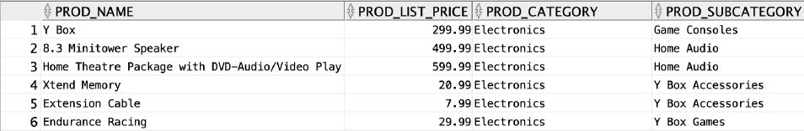
Query granularity
What is the granularity, or level of detail of the result?
SELECT p.prod_name, p.prod_list_price, p.prod_category, p.prod_subcategory
FROM products p
ORDER BY prod_category, prod_subcategory;

Slide 7
Query granularity
How many rows does this return?
SELECT AVG(prod_list_price)
FROM products;

Slide 8

Query granularity
How many rows does this return?
SELECT AVG(prod_list_price)
FROM products;
Much lower granularity

Slide 9
Aggregate Queries
Pseudocode
Add up a running total of the value of prod_list_price in each row
Divide by the number of rows
Output the answer as a single row with a single column
SELECT AVG(prod_list_price)
FROM products;

Slide 10
Aggregate Queries
SUM, COUNT, AVG, STDDEV are aggregate functions
An aggregate function takes multiple numerical values as input and outputs a single numerical value
In databases, multiple numerical values are supplied as multiple rows in a query

Slide 11
Aggregate Queries
What is the average list price for each sub-category of products?
What is the granularity of the resulting query?

Slide 12
Aggregate Queries
Pseudocode
For each row, check the value of PROD_SUBCATEGORY
Create a new bucket (a unit of storage) for each distinct value
In each bucket, initialize a counter for average price at 0.00
Add the value of PROD_LIST_PRICE to its bucket’s counter
For each bucket, divide the running total by the total number of rows
Output one row for each bucket
Granularity is at the level of PROD_SUBCATEGORY

Slide 13
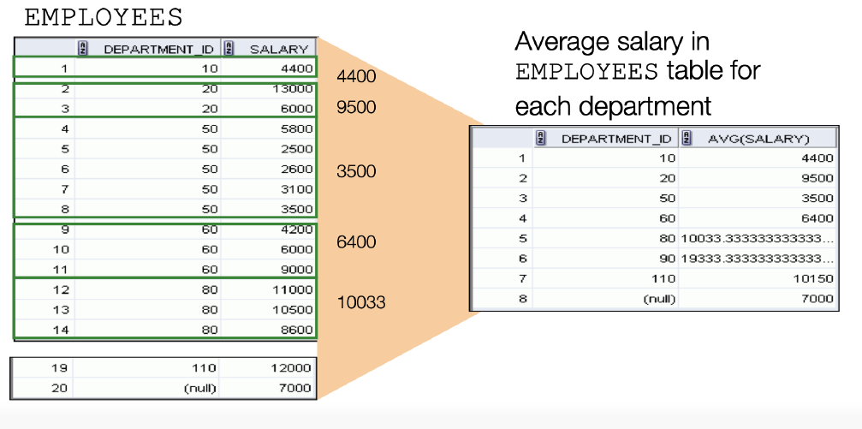
Aggregate Queries

Slide 14
Group By
By default, using any aggregate query will reduce our output table to a single row
If we want to change the granularity we need to tell the database how to create its buckets using the GROUP BY statement
SELECT prord_subcategory, AVG(prod_list_price)
FROM products
GROUP BY prod_subcategory
ORDER BY prod_subcategory;

Slide 15
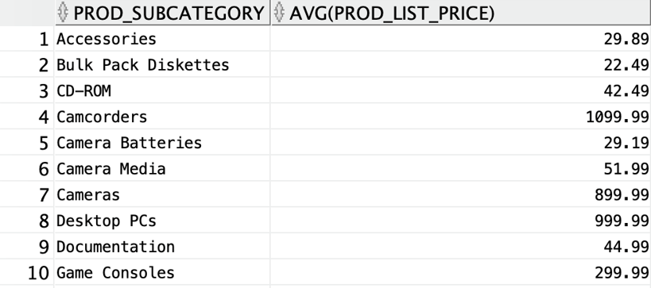
Group By
SELECT prord_subcategory, AVG(prod_list_price)
FROM products
GROUP BY prord_subcategory
ORDER BY prord_subcategory;

Slide 16
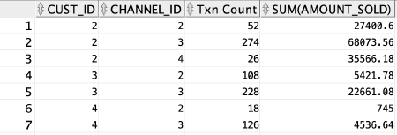
Group By
If we use multiple columns in GROUP BY statement we get one row for each unique combination
SELECT cust_id, channel_id, COUNT(*) "Txn Count", SUM(amount_sold)
FROM sales
GROUP BY cust_id, channel_id
ORDER BY cust_id, channel_id;

Slide 17
Group By
What is the problem?
SELECT cust_id, channel_desc, COUNT(*) "Txn Count", SUM(amount_sold)
FROM sales s
INNER JOIN channels c on s.channel_id = c.channel_id
GROUP BY cust_id
ORDER BY channel_desc;
ORA-00979: not a GROUP BY expression
00979. 00000 - ”not a GROUP BY expression”
*Cause:
*Action:
Error at Line: 1 Column: 17

Slide 18
Group By
If you use any aggregate functions in your query then every column you select must
Be an aggregate function or
Appear in the GROUP BY clause
This ensures that the granularity of your query is compatible

Slide 19
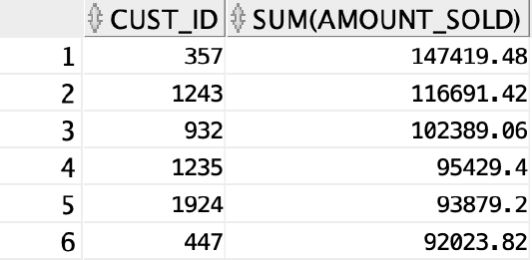
Group By
SELECT cu.cust_id, SUM(amount_sold)
FROM Sales s
INNER JOIN Customers cu on s.cust_id = cu.cust_id
INNER JOIN Countries co on cu.country_id = co.country_id
WHERE co.country_name = 'Canada'
GROUP BY cu.cust_id
ORDER BY SUM(amount_sold) desc;

Slide 20
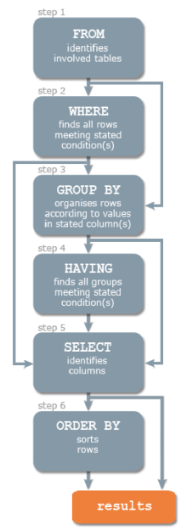
Order of Execution
The SQL engine applies any WHERE clauses before GROUP BY clauses
When we apply the WHERE clause, none of the aggregate functions have yet been calculated
How do we deal with this?

Slide 21
Order of Execution
The WHERE clause lets us filter out rows before our aggregate
functions are calculated
The HAVING clause lets us filter out rows after our aggregate
functions are calculated
We can filter on MAX, MIN, AVG, etc, using a HAVING clause
We can prevent rows from being counted in our aggregate functions using WHERE

Slide 22
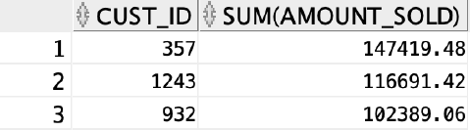
The HAVING clause
SELECT cu.cust_id, SUM(amount_sold)
FROM Sales s
INNER JOIN Customers cu on s.cust_id = cu.cust_id
INNER JOIN Countries co on cu.country_id = co.country_id
WHERE co.country_name = 'Canada'
GROUP BY cu.cust_id
HAVING SUM(amount_sold) > 100000
ORDER BY SUM(amount_sold) desc;

Slide 23
Grouping by Date
Date column types are very flexible for grouping results
We can summarise results over years, months, days, or even minutes
We can use the EXTRACT function to extract the part of the date we are interested in.

Slide 24
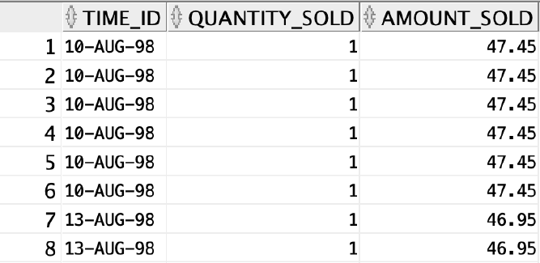
Grouping by Date
SELECT time_id, quantity_sold, amount_sold
FROM sales;

Slide 25
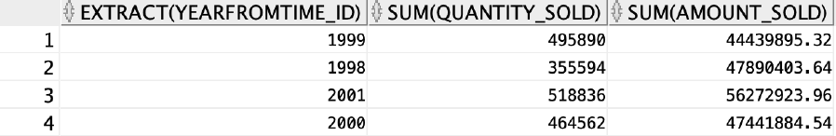
Grouping by Date
SELECT EXTRACT(year FROM time_id), SUM(quantity_sold), SUM(amound_sold)
FROM sales
GROUP BY EXTRACT(year FROM TIME_ID)

Slide 26
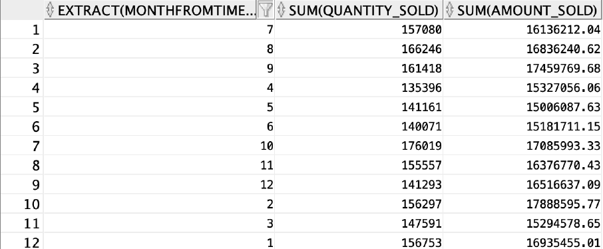
Grouping by Date
SELECT EXTRACT(month FROM time_id), SUM(quantity_sold), SUM(amount_sold)
FROM sales
GROUP BY EXTRACT(month FROM time_id)

Slide 27
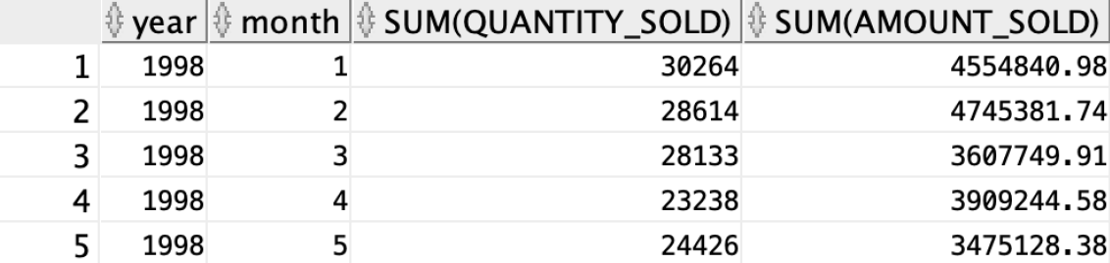
Grouping by Date
SELECT EXTRACT(year FROM time_id) "year",
EXTRACT(month FROM time_id) "month", SUM(quantity_sold),
SUM(amount_sold)
FROM sales
GROUP BY EXTRACT(year FROM time_id), EXTRACT(month FROM time_id)
ORDER BY EXTRACT(year FROM time_id), EXTRACT(month FROM time_id);

Slide 28
Analytic Functions in Oracle

Slide 29
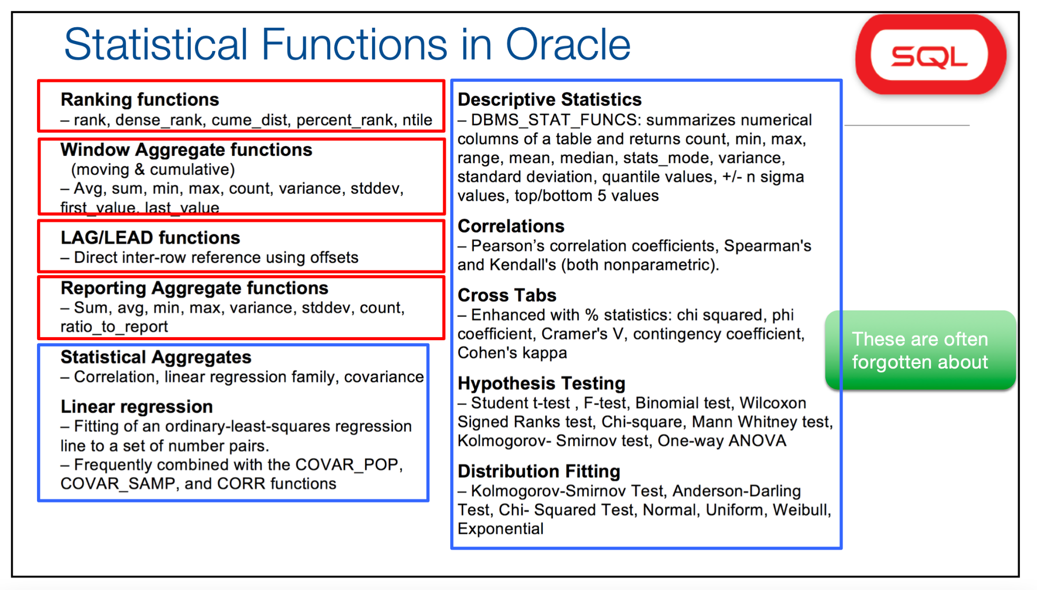
Function Families

Slide 30
Subqueries
Subqueries are supported by all SQL engines
The subquery gets executed first, and then the parent query is run
This has performance implications
For instance, we need to access products twice
SELECT p.prod_name, p.prod_list_price,
(SELECT AVG(prod_list_price) FROM products)
FROM products p
ORDER BY p.prod_list_price;

Slide 31
Subqueries
The EXPLAIN PLAN command can give us more information on the execution plans chosen by the Oracle optimizer
To explain a SQL statement, use the EXPLAIN PLAN FOR clause immediately before the statement
EXPLAIN PLAN FOR
SELECT p.prod_name, p.prod_list_price,
(SELECT AVG(prod_list_price) FROM products)
FROM products p
ORDER BY p.prod_list_price;

Slide 32
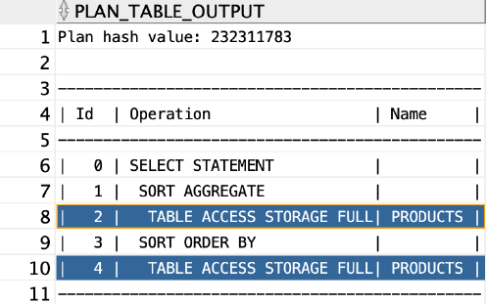
Subqueries
This explains the plan into the PLAN_TABLE table.
You can then select the execution plan from PLAN_TABLE
SELECT plan_table_output
FROM table(dbms_xplan.display('plan_table',null,'basic'));
Two full table scans

Slide 33
Subqueries
We could achieve the same result with a different approach
The OVER clause is powerful in that you can have aggregates over different ranges ("windowing"), whether you use a GROUP BY or not
EXPLAIN PLAN FOR
SELECT p.prod_name, p.prod_list_price,
AVG(prod_list_price) OVER ()
FROM products p
ORDER BY p.prod_list_price;

Slide 34
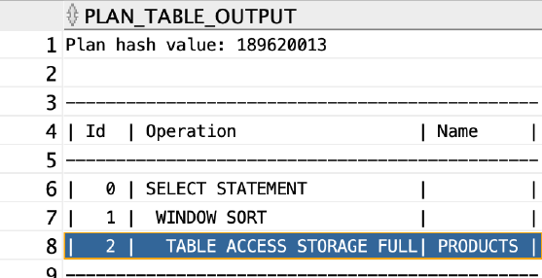
Subqueries
SELECT plan_table_output
FROM table(dbms_xplan.display('plan_table',null,'basic'));

Slide 35
Windowed Queries
OVER ()windows the whole table.
What if we want to specify groups for our analytical function?
Analytic clauses consist of 3 optional subclauses
Query Partition Clause (how to group the query)
Ordering Clause (how to order the groups)
Windowing Clause (when using subsets of the partition)

Slide 36
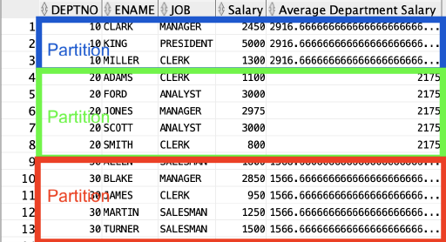
Query Partition Clause
What if we want to calculate the average per department?

Slide 37
Query Partition Clause
What if we want to calculate the average per department?
AVG(sal) OVER (PARTITION BY DeptNo)

Slide 38
Order By Clause
The order of results is often important when we want to rank items
The oracle ROW_NUMBER() function outputs the current row
number of a query
ROW_NUMBER() is an analytical SQL function and needs an OVER clause to work
ROW_NUMBER() doesn’t always match the output row (depends on overall ORDER BY)

Slide 39
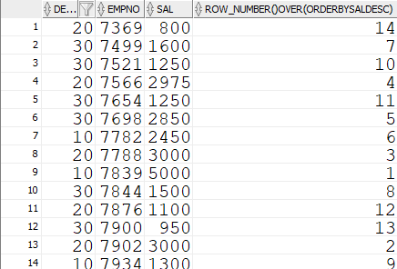
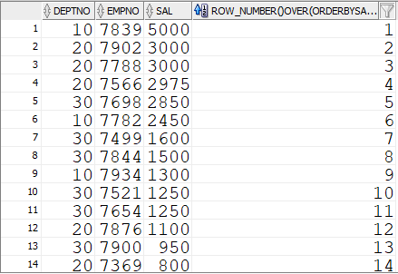
Order By Clause
SELECT deptno, empno, sal,
ROW_NUMBER() OVER (ORDER BY sal desc)
FROM employee
ORDER BY empno;
Actual result
ROW_NUMBER in this case is the same as the salary rank

Slide 40
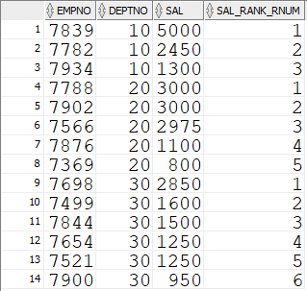
Order By Clause
We can combine an order by clause with a partition clause
This allows us to rank an item only within its own group
SELECT empno, deptno, sal,
ROW_NUMBER () over (PARTITION BY deptno ORDER BY sal desc) sal_rank_rnum
FROM employee
ORDER BY deptno, sal desc;

Slide 41
Lag and Lead
The LAG and LEAD analytical functions let us peek ahead or peek behind our current row
These need an ORDER BY clause for them to be meaningful
Particularly useful for calculating month-on-month change or difference in an ordered list
LAG and LEAD take a second optional parameter, offset specifying the number of rows to skip

Slide 42
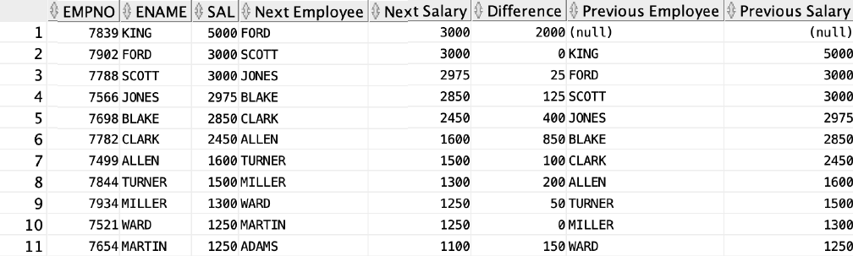
Lag and Lead
SELECT empno, ename, sal,
LEAD(ename) OVER (ORDER BY sal desc) "Next Employee",
LEAD(sal) OVER (ORDER BY sal desc) "Next Salary",
sal - LEAD(sal) OVER (ORDER BY sal desc) "Difference",
LAG(ename) OVER (ORDER BY sal desc) "Previous Employee",
LAG(sal) OVER (ORDER BY sal desc) "Previous Salary"
FROM emp;

Slide 43
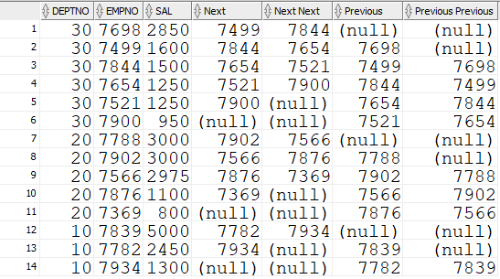
Lag and Lead
SELECT deptno, empno, sal,
LEAD(empno) OVER (PARTITION BY deptno ORDER BY sal desc) "Next",
LEAD(empno, 2) OVER (PARTITION BY deptno ORDER BY sal desc) "Next Next",
LAG(empno) OVER (PARTITION BY deptno ORDER BY sal desc) "Previous ",
LAG(empno, 2) OVER (PARTITION BY deptno ORDER BY sal desc) "Previous Previous"
FROM employee
ORDER BY deptno desc;

Slide 44
Lag and Lead
SELECT deptno, empno, sal,
LEAD(empno) OVER (PARTITION BY deptno ORDER BY sal desc) "Next",
LEAD(empno, 2) OVER (PARTITION BY deptno ORDER BY sal desc) "Next Next",
LAG(empno) OVER (PARTITION BY deptno ORDER BY sal desc) "Previous ",
LAG(empno, 2) OVER (PARTITION BY deptno ORDER BY sal desc) "Previous Previous"
FROM employee
ORDER BY deptno desc;
Different offsets

Slide 45
Windowing Clause
Sometimes you may want to use only a portion of your partition in a calculation
Commonly used when calculating running totals e.g. sales
year-to-date

Slide 46
Windowing Clause
RANGE BETWEEN start AND end
ROWS BETWEEN start AND end
UNBOUNDED PRECEDING Window starts at first row of partition
UNBOUNDED FOLLOWING Window ends at last row of partition
CURRENT ROW
Window starts or ends at the current row
value_expr PRECEDING Window starts specified number of rows before current row
value_expr FOLLOWING Window ends specified number of rows before current row

Slide 47
Windowing Clause
select empno, deptno, sal,
SUM(sal) OVER
(PARTITION BY deptno ORDER BY sal
ROWS BETWEEN UNBOUNDED PRECEDING AND CURRENT ROW)
AS AVG_DEPARTMENT_SALARY_1,
SUM(sal) OVER
(PARTITION BY deptno ORDER BY sal
ROWS BETWEEN UNBOUNDED PRECEDING AND UNBOUNDED FOLLOWING)
AS AVG_DEPARTMENT_SALARY_2,
SUM(sal) OVER
(PARTITION BY deptno ORDER BY sal)
AS AVG_DEPARTMENT_SALARY_3
FROM emp;

Slide 48
Windowing Clause
select empno, deptno, sal,
SUM(sal) OVER
(PARTITION BY deptno ORDER BY sal
ROWS BETWEEN UNBOUNDED PRECEDING AND CURRENT ROW)
AS AVG_DEPARTMENT_SALARY_1,
SUM(sal) OVER
(PARTITION BY deptno ORDER BY sal
ROWS BETWEEN UNBOUNDED PRECEDING AND UNBOUNDED FOLLOWING)
AS AVG_DEPARTMENT_SALARY_2,
SUM(sal) OVER
(PARTITION BY deptno ORDER BY sal)
AS AVG_DEPARTMENT_SALARY_3
FROM emp;
Sum from first row until current row by deptno

Slide 49
Windowing Clause
select empno, deptno, sal,
SUM(sal) OVER
(PARTITION BY deptno ORDER BY sal
ROWS BETWEEN UNBOUNDED PRECEDING AND CURRENT ROW)
AS AVG_DEPARTMENT_SALARY_1,
SUM(sal) OVER
(PARTITION BY deptno ORDER BY sal
ROWS BETWEEN UNBOUNDED PRECEDING AND UNBOUNDED FOLLOWING)
AS AVG_DEPARTMENT_SALARY_2,
SUM(sal) OVER
(PARTITION BY deptno ORDER BY sal)
AS AVG_DEPARTMENT_SALARY_3
FROM emp;
Sum of all rows by deptno

Slide 50
Windowing Clause
select empno, deptno, sal,
SUM(sal) OVER
(PARTITION BY deptno ORDER BY sal
ROWS BETWEEN UNBOUNDED PRECEDING AND CURRENT ROW)
AS AVG_DEPARTMENT_SALARY_1,
SUM(sal) OVER
(PARTITION BY deptno ORDER BY sal
ROWS BETWEEN UNBOUNDED PRECEDING AND UNBOUNDED FOLLOWING)
AS AVG_DEPARTMENT_SALARY_2,
SUM(sal) OVER
(PARTITION BY deptno ORDER BY sal)
AS AVG_DEPARTMENT_SALARY_3
FROM emp;
Sum from first row until current current row by deptno (same as first sum)

Slide 51
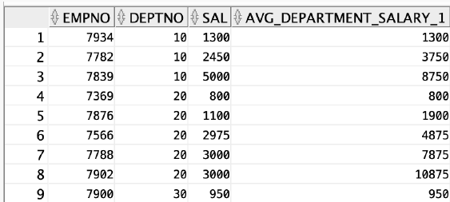
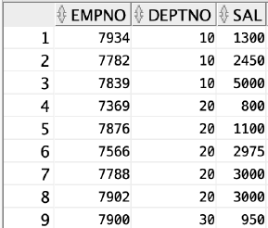
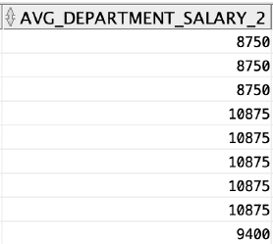
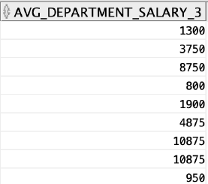
Windowing Clause
select empno, deptno, sal,
SUM(sal) OVER
(PARTITION BY deptno ORDER BY sal
ROWS BETWEEN UNBOUNDED PRECEDING AND CURRENT ROW)
AS AVG_DEPARTMENT_SALARY_1,
SUM(sal) OVER
(PARTITION BY deptno ORDER BY sal
ROWS BETWEEN UNBOUNDED PRECEDING AND UNBOUNDED FOLLOWING)
AS AVG_DEPARTMENT_SALARY_2,
SUM(sal) OVER
(PARTITION BY deptno ORDER BY sal)
AS AVG_DEPARTMENT_SALARY_3
FROM emp;

Slide 52
Calculating Moving Average
A moving average tracks a numeric value as it changes over time
Day-to-day cases may fluctuate but the moving average gives a better idea of trend
To calculate a moving average over a 4-month period we take the average value of the current month together with the 3 previous month’s values

Slide 53
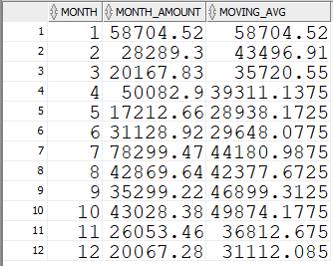
Calculating Moving Average
SELECT month, month_amount, AVG(month_amount) OVER (ORDER BY month ROWS BETWEEN 3 PRECEDING AND CURRENT ROW) AS moving_avg
FROM sales
ORDER BY month;

Slide 54
Calculating Moving Average
SELECT month, month_amount, AVG(month_amount) OVER (ORDER BY month ROWS BETWEEN 3 PRECEDING AND CURRENT ROW) AS moving_avg
FROM sales
ORDER BY month;

Slide 55
Calculating Moving Average
SELECT month, month_amount, AVG(month_amount) OVER (ORDER BY month ROWS BETWEEN 3 PRECEDING AND CURRENT ROW) AS moving_avg
FROM sales
ORDER BY month;

Slide 56
Calculating Moving Average
SELECT month, month_amount, AVG(month_amount) OVER (ORDER BY month ROWS BETWEEN 3 PRECEDING AND CURRENT ROW) AS moving_avg
FROM sales
ORDER BY month;

Slide 57
Calculating Moving Average
SELECT month, month_amount, AVG(month_amount) OVER (ORDER BY month ROWS BETWEEN 3 PRECEDING AND CURRENT ROW) AS moving_avg
FROM sales
ORDER BY month;

Slide 58
Calculating Moving Average
SELECT month, month_amount, AVG(month_amount) OVER (ORDER BY month ROWS BETWEEN 3 PRECEDING AND CURRENT ROW) AS moving_avg
FROM sales
ORDER BY month;

Slide 59
Calculating Moving Average
SELECT month, month_amount, AVG(month_amount) OVER (ORDER BY month ROWS BETWEEN 3 PRECEDING AND CURRENT ROW) AS moving_avg
FROM sales
ORDER BY month;

Slide 60
Next Steps
Oracle has hundreds of analytical functions available for use
These are useful both in exploring data yourself, and as input to machine learning models
There is extensive documentation on each of the analytic functions available online
Once you understand aggregate queries, and windowed queries you should be able to use any function you like
Check the links for the Oracle Tutorials in Brightspace

Slide 61
Lab
Lab and data sample on Brightspace

Slide 62
Questions?

